Slide 1
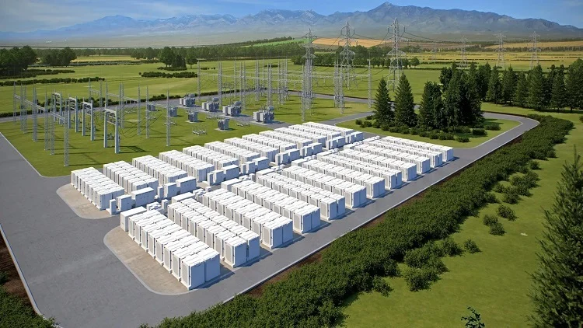
Grid Level
Battery Optimization
Team 1

Slide 2
Introduction and Motivation
As the grid begins to rely further and further upon renewable resources, battery storage is going to be a lot more common in order to flatten the energy surplus during sunny and windy hours, as well as raise the energy deficit during cloudy/nighttime and calm hours. This will require more advanced battery storage algorithms in order to optimize energy sales while considering the day ahead and real time prices.
How can we optimize grid level battery charging to maximize energy sales while minimizing battery degradation?

Slide 3
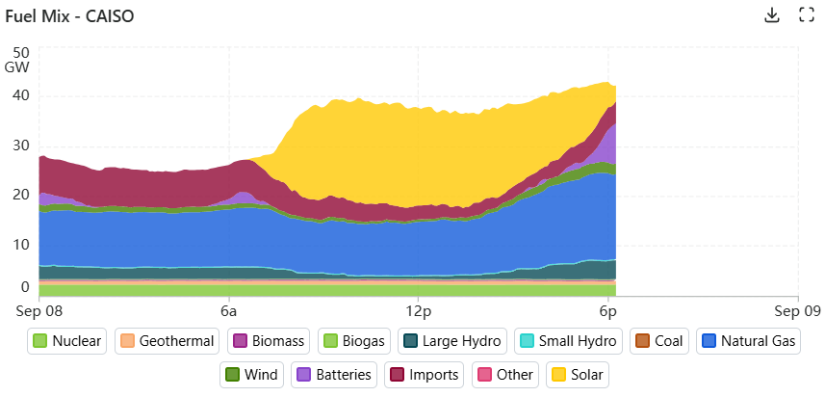
Notes:
Zack:
This is just CAISO, but this is where the grid is headed

Slide 4
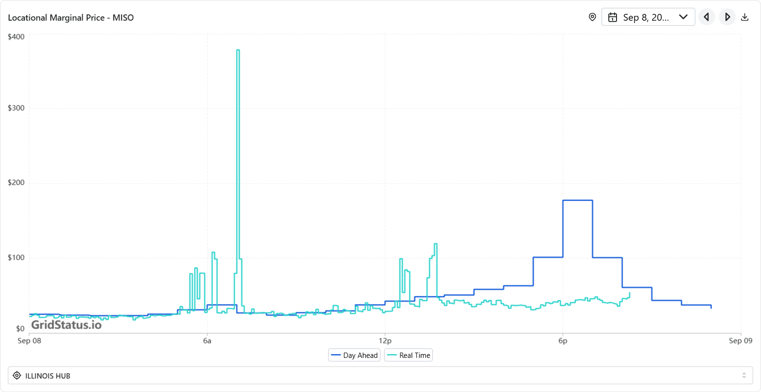
Context: Energy Market
Day Ahead Market
Real Time Market
Notes:
Alex

Slide 5
Data
LMP Day Ahead - for day ahead market optimization.
LMP Real Time 5 min - for real time adjustments
LMP Real Time Final
Battery decay function - for charge/discharge penalty
LMP Future Predictions - for more fine tune adjustments/ optimization planning
  Option A - Use real data (LMP Day ahead)
  Option B - Build our own model based on weather data, load forecasts, etc.
Solar Forecast
Wind Forecast
Load Forecast
Outage Forecast
https://www.gridstatus.io/datasets?source=miso
Problem: API Access and querying . Can we get funding???

Slide 6
Real Time Prediction
Using wind forecasts, solar forecasts, outage data, additional weather data, etc. Build a model to predict real time prices
Evaluation: Compare predicted to true price

Slide 7
Optimization Algorithm
Using predicted prices mathematically determine the optimal times to charge and discharge our theoretical batteries
Penalize wear on battery

Slide 8
Reinforcement Learning Model
Can we get more computing power???
Evaluation: Compare historical battery earnings to our battery earnings (scaled to battery capacity)
Take in
  Current true real time
  Predicted real time for the next 24 hours
  Day ahead
Output
  Charge, Hold, or Discharge
Evaluation
  Compare to real battery earnings (scaled for capacity)
  Compare to algorithm
Notes:
Zack

Slide 9
Possible Issues
Will need access to an API key from GridStatus (ongoing) and may need funds for it
  Working on getting in contact with the company
May need high performance computing for the reinforcement learning
Lack of general knowledge in the energy sector

Slide 10
Future Extensions (If there’s time)
Integrate other market prices into the prediction model (uranium, stock market, etc)
Rough ideas for integrating news cycles into the prediction model
  Would be challenging
  Would require text mining
Notes:
Tommy

Slide 11
Questions

